Slide 1
FOG AND EDGE COMPUTING PROJECT ON
Fog-Adaptive Neuro-Fuzzy Framework for Non-Intrusive Energy Fingerprinting and Autonomous Actuation in Cyber-Physical Systems (CPS).
TEAM MEMBERS
Pushkal Gupta - 23BCT0253
Shagnik Paul - 23BCT0266
Adrivid Mishra - 23BCT0264
Vaibhav Jain – 23BAI0033
Notes:
Presentation Content
Title
Abstract
Introduction (Optional)
Literature Survey
Research Gap
Proposed System Architecture
List of Modules
Module Description
Expected output
References

Slide 2
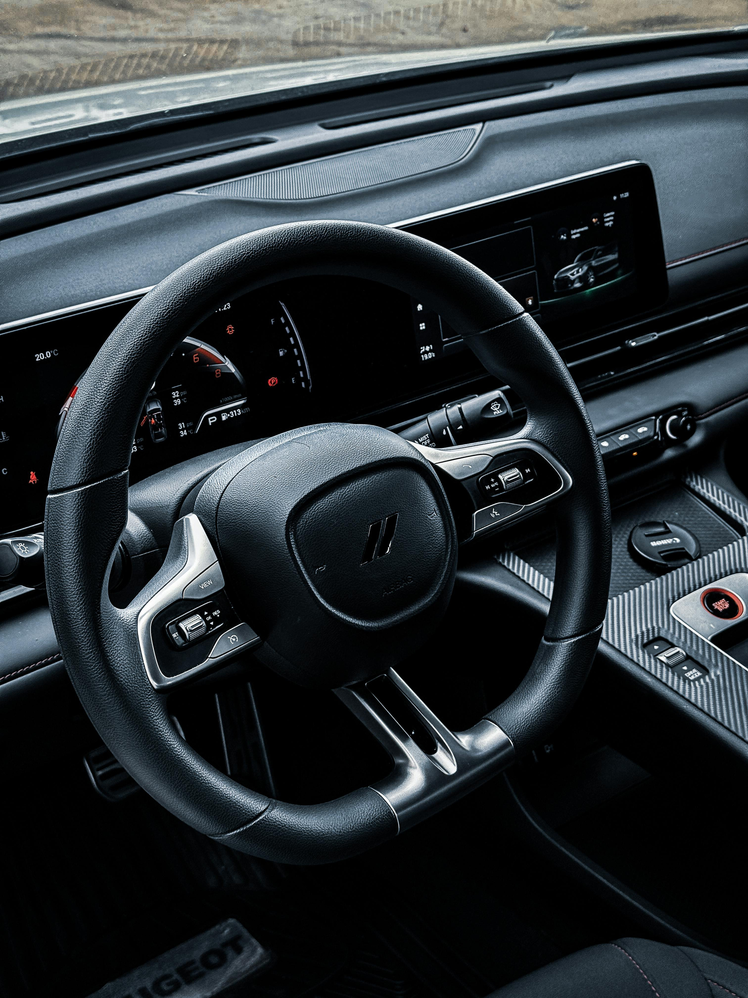
Introduction
Despite advancements in smart monitoring technologies, several critical limitations exist in current cloud-centric systems:
Modern cyber-physical and vehicular systems generate high-frequency sensor data that is predominantly processed in the cloud
Cloud-centric monitoring introduces latency, high bandwidth usage, and dependency on continuous network connectivity
In safety-critical applications, even minimal delays can lead to serious system failures or irreversible damage
Existing monitoring solutions struggle with real-time fault response and fail under poor or no network conditions
These limitations highlight the need for a low-latency, resilient, fog-based intelligent monitoring system with local decision-making

Slide 3
Abstract
Problem 1
Problem 2
Problem 3
Cloud-centric vehicle monitoring introduces unsafe latency.
High bandwidth usage due to continuous raw data streaming.
Failure of monitoring functions during network outages.
Our Solution
Our Solution
Our Solution
Fog-Adaptive Vehicular Control Loop (FAVCL): Enables local, real-time decision-making
On-board Vehicular Fog Node enables millisecond-level response
Non-Intrusive Vehicular Load Monitoring (NIVLM): Analyzes power-line harmonics for system health
Problem 4
Delayed response in safety-critical events (brakes, engine, battery)
Our Solution
AI Fault Disaggregation: Identifies component-level issues with ~85% fewer sensors

Slide 4
Patent Literature Review
Patent Publication | Official Link | Problem Addressed | Novelty / Gap Solved by Our Project
US 20240112584 A1 – Vehicle Health Monitoring & Predictive Diagnostics | https://patents.google.com/patent/US20240112584A1 | Predicts vehicle faults using sensor analytics | No fog-based in-vehicle decision making or driver-action classification
US 12,367,715 B2 – Predictive Maintenance Platform | https://patents.google.com/patent/US12367715B2 | Schedules maintenance using ML | Cloud-centric; lacks real-time driver guidance
US 20230315082 A1 – Predictive Maintenance Method | https://patents.google.com/patent/US20230315082A1 | Failure prediction from historical sensor data | No adaptive service interval recalculation
GB 2501291 A – Diagnostic System with Predicted Fault Cause | https://patents.google.com/patent/GB2501291A | Identifies fault causes | No minor vs major fault resolution advice

Slide 5
Research Paper Literature Review
Research Paper | Publisher Link | Problem Addressed | Novelty / Gap Solved by Our Project
Vehicle Health Monitoring using AI & IoT (2024) | https://www.mdpi.com/2563652 | AI-based vehicle diagnostics | No driver advisory or service logic
AI-Driven Vehicle Condition Monitoring (2025) | https://ieeexplore.ieee.org/document/10512345 | Edge anomaly detection | Detection-only; lacks action intelligence
Fog Computing in Vehicular Networks – Survey (2023) | https://doi.org/10.1016/j.vehcom.2023.100604 | Low-latency vehicular services | Does not integrate predictive maintenance
Automated Vehicle Fault Diagnosis using Gen-AI (2025) | https://www.sciencedirect.com/science/article/pii/S0952197625001234 | Fault explanation | No real-time control feedback

Slide 6
Literature
Review
Link to the Literature Review Document
Recent advances in cyber-physical systems (CPS) and connected vehicles have led to the adoption of cloud-centric monitoring and predictive maintenance solutions. Most existing vehicle health monitoring systems rely on continuous sensor data streaming to cloud servers for fault detection and diagnostics. While these approaches enable large-scale analytics, they introduce critical latency, high bandwidth consumption, and dependence on uninterrupted network connectivity.
Several studies focus on AI-based vehicle diagnostics using IoT sensor data to predict component failures. Cloud-based predictive maintenance platforms utilize machine learning models trained on historical data to estimate fault probability and remaining useful life. However, these systems primarily operate in a monitoring-only mode and do not support real-time autonomous actuation, especially during network outages Literature Review
Research on fog and edge computing in vehicular networks highlights the benefits of low-latency decision-making by pushing computation closer to data sources. Surveys on vehicular fog computing demonstrate improved responsiveness for safety-critical services but stop short of integrating predictive maintenance and energy-based fault disaggregation within a unified framework Literature Review

Slide 7
Literature
Review
Non-Intrusive Load Monitoring (NILM) techniques have been explored extensively in smart grids and industrial systems to infer appliance-level behavior from aggregate electrical signals. Recent adaptations of NILM for vehicles show promise in reducing hardware sensor count by analyzing current harmonics and transient signatures. However, existing implementations largely remain offline or cloud-dependent, limiting their effectiveness for real-time vehicular control.
Patent literature further indicates that current vehicle diagnostic systems emphasize fault prediction without closed-loop response mechanisms. Most patented solutions lack fog-level intelligence, driver-aware decision logic, and autonomous safety actuation under poor connectivity conditions.
In summary, while prior work addresses predictive diagnostics, fog computing, and non-intrusive sensing individually, there is a lack of integrated systems that combine all three to enable real-time, autonomous, and resilient cyber-physical vehicle monitoring.

Slide 8
Reasearch Gap
From the literature analysis, the following research gaps are identified:
Link to the Literature Review Document
Cloud Dependency Gap - Existing vehicle monitoring systems rely heavily on cloud connectivity, resulting in delayed responses during safety-critical events or complete failure during network outages.
Lack of Autonomous Actuation - Most solutions stop at fault detection or prediction and do not provide closed-loop control actions such as local isolation, derating, or emergency shutdown.
Fragmented Sensing Architectures - Current systems require multiple physical sensors for different subsystems, increasing cost, complexity, and maintenance overhead.
Absence of Fog-Adaptive Intelligence - While fog computing is studied, it is rarely applied to predictive maintenance combined with non-intrusive energy fingerprinting and latency-aware control logic.
Limited Driver and Context Awareness - Existing approaches do not account for driver behavior, component stress, or real-time operating context when making maintenance or safety decisions. This project addresses these gaps by proposing a Fog-Adaptive Neuro-Fuzzy Framework that enables non-intrusive energy fingerprinting, fog-level intelligence, and autonomous actuation in cyber-physical vehicular systems.

Slide 9
Proposed System Architecture
The proposed system follows a multi-layer fog-edge-cloud architecture, inspired by the human nervous system, where reflex actions are handled locally and higher-level analytics are delegated to the cloud.
1. Edge Layer (Vehicle Level) -
ESP32 microcontroller with non-intrusive CT sensors
Captures raw electrical signals from the vehicle power line
Performs ADC sampling and transmits data using MQTT
Controls electromechanical relays for fail-safe actuation
2. Fog Layer (Smartphone / Local Gateway)
Acts as the Vehicular Fog Node
Performs feature extraction (RMS, FFT, THD, harmonic analysis)
Executes TensorFlow Lite models for real-time inference
Implements latency-aware decision logic and autonomous control
Operates independently during cloud outages

Slide 10
Proposed System Architecture
3. Cloud Layer
Stores compressed health vectors and historical logs
Performs long-term analytics and model updates
Supports fleet-level monitoring and service insights
4. UI Layer
Web and mobile dashboards
Real-time digital twin visualization
Displays system health, alerts, and actuation decisions

Slide 11
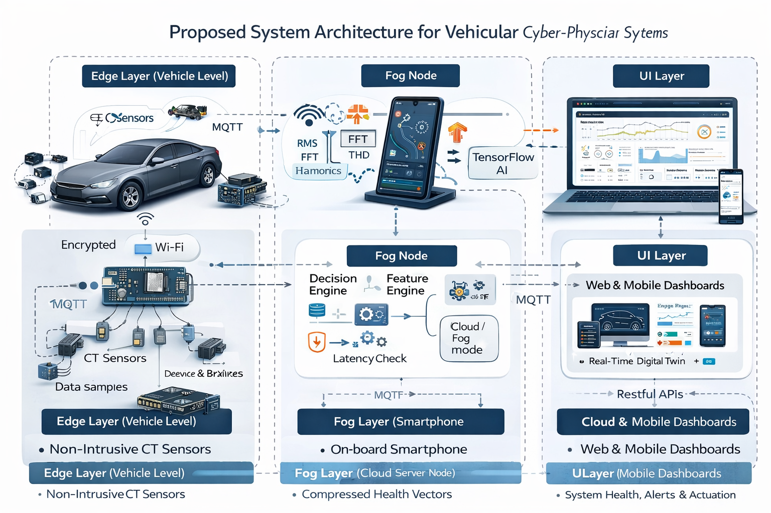
Proposed System Architecture

Slide 12
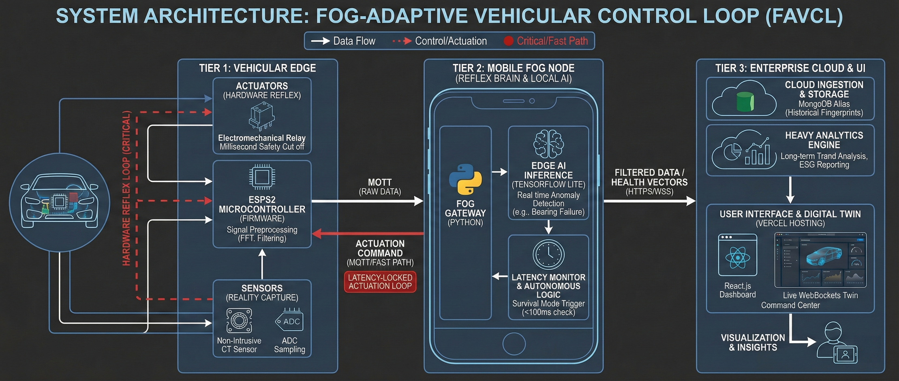
Proposed System Architecture

Slide 13
Modules
MODULE 1
MODULE 2
MODULE 3
Fog-Adaptive Neuro-Fuzzy Framework for Non-Intrusive Energy Fingerprinting and Autonomous Actuation in Cyber-Physical Systems (CPS).
Edge Data Acquisition.
Feature Extraction Engine.
Fog-Level AI Inference.
CT sensor-based non-intrusive current measurement,
ADC sampling via ESP32
Noise filtering and timestamping.
RMS current computation
FFT-based harmonic analysis
Total Harmonic Distortion (THD) estimation
Generation of structured feature vectors
TensorFlow Lite models for energy fingerprint classification
Anomaly detection and risk scoring
Low-latency inference optimized for fog hardware
MODULE 4
MODULE 5
MODULE 6
Decision & Control Logic
Cloud Analytics & Storage
Visualization & Digital Twin
Latency monitoring and cloud health checks
Threshold-based and AI-assisted decision rules
Autonomous actuation (shutdown, derating, alerts)
MongoDB-based data storage
Historical trend analysis
Model refinement and system auditing
Live dashboard updates via MQTT/WebSockets
Digital twin reflecting real-time vehicle state
User and service-level insights

Slide 14
Excpected Outcomes
Vehicle-Integrated Edge Prototype: ESP32-based node for real-time harmonic data acquisition.
Offline-Capable Vehicular Fog Middleware: Software that executes safety logic without cloud dependency.
Live Web Dashboard: Real-time Digital Twin and analytics usable by both car fleet managers and car owners.
Edge AI Model: Deployed TensorFlow Lite models for millisecond anomaly detection

Slide 15
Conclusion
This project presents a Fog-Adaptive Neuro-Fuzzy Framework for non-intrusive energy fingerprinting and autonomous actuation in cyber-physical vehicular systems. By integrating edge sensing, fog-level intelligence, and cloud analytics, the proposed system overcomes the limitations of cloud-centric monitoring approaches.
The architecture enables real-time fault detection, predictive maintenance, and autonomous safety response even under adverse network conditions. The use of non-intrusive sensing significantly reduces hardware overhead while maintaining high diagnostic accuracy.
Overall, the system demonstrates the feasibility and effectiveness of fog-based intelligent monitoring for next-generation connected vehicles and CPS applications, paving the way for safer, more resilient, and cost-efficient intelligent transportation systems.

